Slide 1

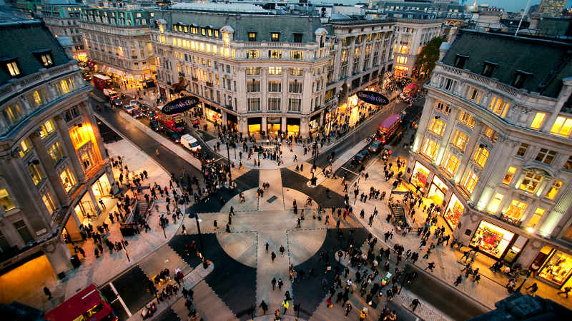
Determine best locations to SETUP new stores for a fashion retailer in Paris

Slide 2
Problem: A renowned fashion retailer, has begun the rollout of their new stores, which begins in Paris. As they are new to Paris, they would need some help in determining which locations would be best to setup their new stores that can eventually attract a lot of people. Solution: As part of this project, we are going to make data-driven decisions on the new locations/ districts that are more suitable for their new stores in Paris.
Target audience: This project is going to help any fashion retailer planning to set up their stores in Paris, which is the hub of fashion, explore which location in Paris would be perfect to establish their stores.

Slide 3
Criteria: This retailer brand is not what can be considered as high-end, but they are positioned in the mid-range of the fashion industry. So they do not seek to establish their stores in premium/ plush localities, but rather, in high traffic areas where consumers go for shopping, visit restaurants or go for entertainment.
Observing the data from the other retail stores suggests that the best locations to open new stores may not only be where there are other fashion outlets, but in fact, the best areas are near French restaurants, cafes, wine bars.

Slide 4
DATA ACQUISITION AND CLEANING
Data Source:
https://opendata.paris.fr/explore/dataset/arrondissements/table/?dataChart
We will also use FourSquare location data to explore or compare all the 20 districts around Paris
Data Cleaning: Initially the downloaded data had many invalid characters and numbers in exponential values, which had to be replaced by correct ones. Secondly, the column names had to be replaced with a more meaningful names for better understanding. Thirdly, some of the data which were not necessary in the analysis had to be removed.

Slide 5
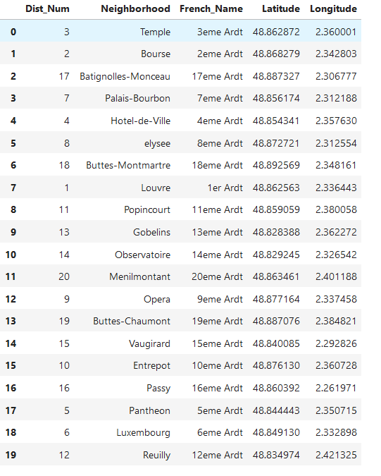
Cleaned up data

Slide 6
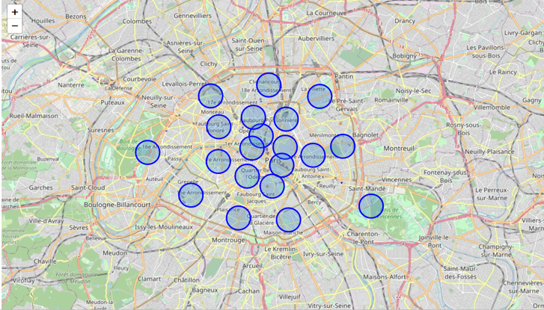
Data Visualization Map of Paris with all 20 districts

Slide 7
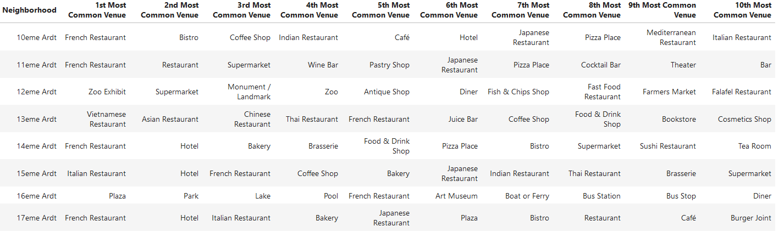
We will use the Foursquare API to explore the Districts of Paris (Neighbourhoods)
Analyse each neighbourhood (one hot encoding) and see the most common top 10 venues for each of them

Slide 8
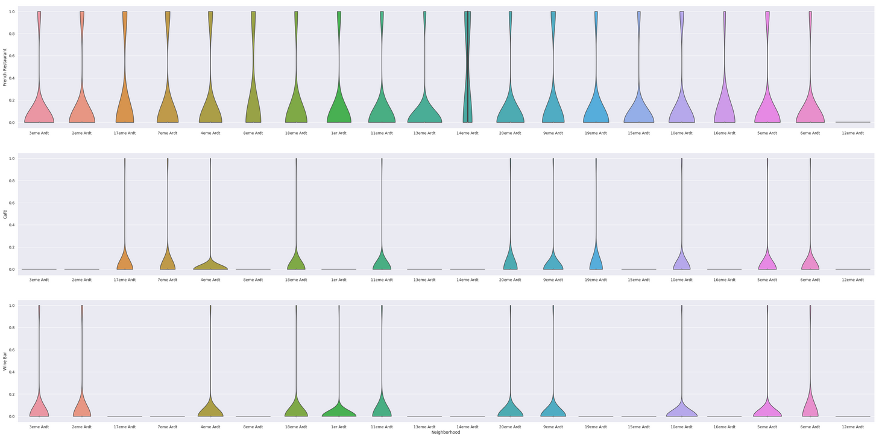
The business criteria was to setup stores where there are 'French Restaurants', 'Cafés' and 'Wine Bars’ - using violin plot to analyze the frequency of distribution of these three venues

Slide 9
Analysing the plot, there are 8 neighbourhoods where the client can open their new stores, as the 3 specified venues (French Restaurants, Cafes and Wine Bars) are in a great frequency there. The neighbourhoods are:
Neighbourhoods
4eme Ardt
5eme Ardt
6eme Ardt
9eme Ardt
10eme Ardt
11eme Ardt
18eme Ardt
20eme Ardt

Slide 10
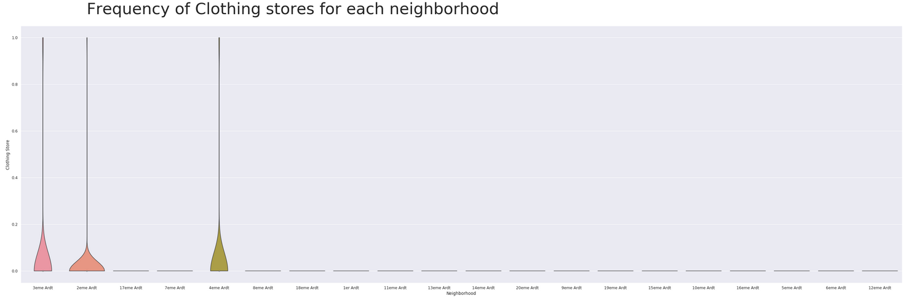
Including an additional venue category, "Clothing_Store" into the analysis, then we might be able to make some inferences based on the data

Slide 11
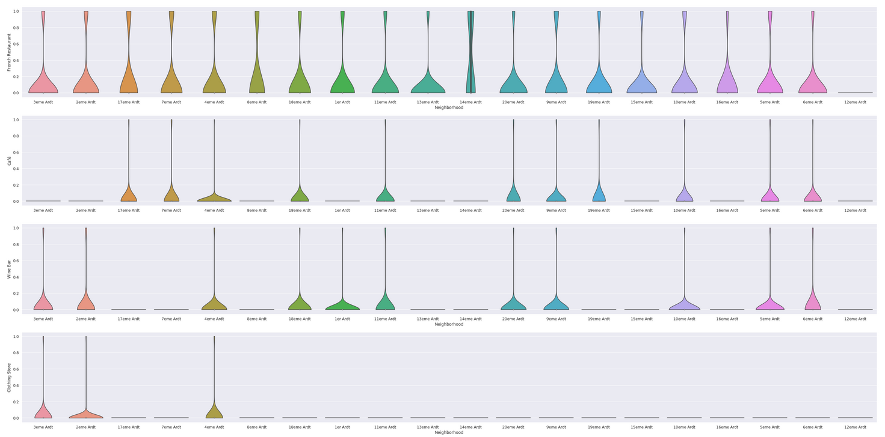
Analyzing the combined plot of Clothing_Store and the plot with 3 venues - we see that there is only 1 neighborhood filtered out of 8 – 4eme Ardt

Slide 12
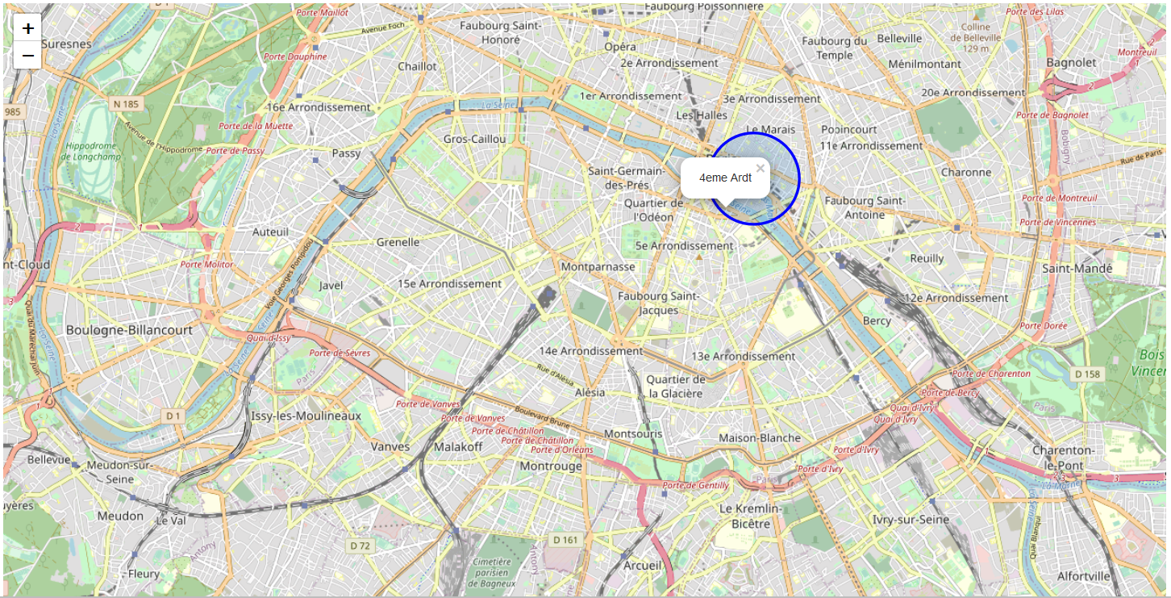
Visualize the chosen neighborhood on the map of Paris

Slide 13
Conclusions
There are many ways this analysis could have been performed based on different methodologies and perhaps different data sources. I chose the method I selected as it was a straightforward way to narrow down the options. The analysis and results are not an end point, but rather a starting point that will guide the next part of the process to find specific store locations. The next part will involve domain knowledge of the industry, and perhaps, of the city itself. But the data analysis and resulting recommendations have greatly narrowed down the best district options based on the data available.

Slide 14
Thank You!

